Slide 1
Engineering Experimentation
AER213

Slide 2
Measurand: unknown numerical values for certain physical variables.
The measurement system senses the measurand and produces a unique numerical value that describes the measurand.

Slide 3
Generalized Measurement System
Sensing Element
Signal Modification Subsystem
Indicator and/or Recorder
Measurand

Slide 4
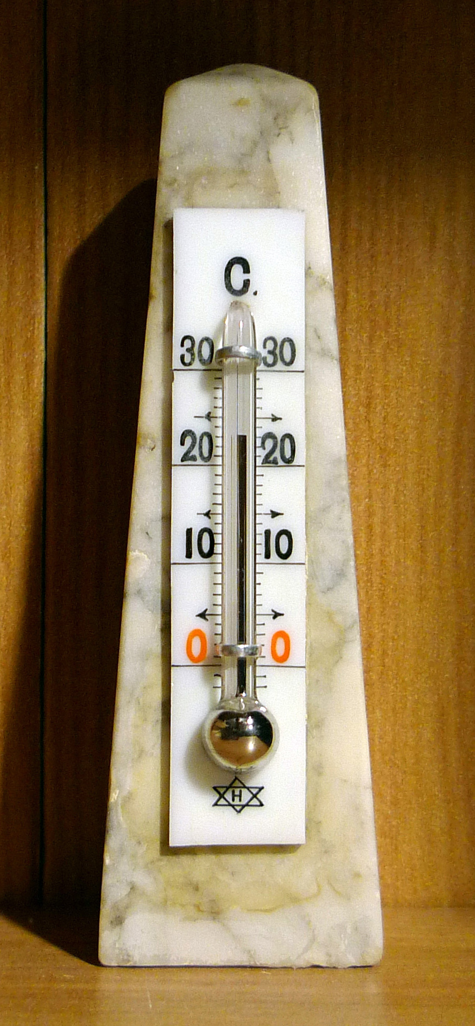
Mercury in the Bulb: sensing element
Stem: signal modification subsystem
Scale: indicator

Slide 5
Measurement Errors
Error of a measurement is defined as the difference between the measured value and the true value of the measurand
  error = measured value – true value
Uncertainty is an estimate of the limits of error in the measurement.
Errors in experiments:
  Systematic errors (fixed or biased errors)
  Random errors (precision errors)

Slide 6
Systematic Errors: are consistent and repetable
The first major source of systematic error results from calibration. This is called Calibration Errors
Second source is Loading Errors:
  The themormeter is intrusive measurement device
  Some measuring devices with negligible loading errors are called nonintrusive
Third source is because the measuring system is affected by variables other than the measurand and is called spatial error.

Slide 7
Random Errors: are those caused by a lack of repeatability in the output of the measuring system.
random error = reading – average of readings
systematic error = average of readings – true value

Slide 8
Random errors can originate from the measuring system itself, from the experimental system, or from the environment.
Random errors are usually caused by uncontrolled variables in the measurement process. They can often be minimized by eliminating uncontrolled variables or properly shielding or grounding the measuring system.
Remaining random errors may be amenable to statistical analysis.

Slide 9
range
A measuring system is only designed to operate over a specified range of measurements.
The range of a measuring system describes the values of the measurand to which that measuring system will respond properly. Values outside the range are not expected to produce useful output.

Slide 10
accuracy
Accuracy defined as the closeness of agreement between a measured value and the true value. This is a common term used to specify uncertainty.
Measurement device manufacturers frequently state a vlue for accuracy as part of the device specifications.
Although the accuracy is generally used, it the inaccuracy that is specified.

Slide 11
precision
Precision is used to describe a measuring system or component and characterizes the random error.
A highly precise measuring system will give the same value each time it is read, but it may not be very accurate.
It simply give the same inaccurate answer each time the measurement is made.
Accuracy and precision are overall characteristics that describe the validity of measurement.

Slide 12
hysteresis
In measuring devices, accuracy is often degraded by a phenomenon known as hysteresis.
For the same value of the measurand, different output readings may be obtained.
Hysteresis is is caused by such effects as friction, meachanical flexure and electrical capacitance.

Slide 13
Hysteresis errors
Errors due to hysteresis are known as hysteresis errors.
İf a measurement is repeated in exactly the same manner, errors due to hysteresis would be repeateble and hence would be considered systematic errors.
However, in common measuring processes the experimenter generally may not know if the measurand was increasing or decreasing when a measurement is made. Hence, the effect of hysteresis will appear random. However, when estimating total uncertainty, it is normal to treat hysteresis errors as a systematic error.

Slide 14
resolution
İs a measurand is varied continuously, many measurement devices will Show an output that cahnges in discrete steps. This inability of the measurement system to follow changes in the measurand exactly results in a resolution error.
Resolution is ususally treated as random error.
Internal characteristics of a measuring system may limit resolution.

Slide 15
readability
İn instruments in which the output is read by comparing a pointer scale, the ability to resolve a value of the measurand is limited by the characteristic called the scale readability.

Slide 16
repeatability
İs the ability of a device to produce the same output reading when the same measurand is applied using the same procedure.
Inability to read a measurement exactly, a random error known as repeability error.

Slide 17
Although not a requirement for a measurement system, it is highly desirable that it have a linear relationship between input and output.
This means that the change in output is proportional to the change in the value of the measurand.
The linearity is useful since it simplifies the calibration and checkin that the device has low error.
Deviation from linearity is a systematic error and is called linearity error.
Linearity error is usually a component of the specification of accuracy.

Slide 18
Measurement systems normally have a point in their range called the zero or null point.
If the device does not have correct output at the zero point; it is said to have a zero offset
Manufacturers may also specify the maximum expected zero error, often using the term zero balance

Slide 19
sensitivity, defined as the ratio of the change in magnitude of the output to the change in magnitude of the measurand:
Sensitivity is determined during the process of calibration, and an error in determining the actual sensitivity results in a systematic error called sensitivity error, which affects all readings

Slide 20
Over a period of time, the output of a measuring system for a fixed measurand may change even though all environmental factors remain constant. This undesirable characteristic is known as drift.

Slide 21
calibration, a process in which a set of measurements are made of measurand values that can be determined independently. The readings can then be compared to the known "true" values and the errors determined.
The number of different values of measurand required for the calibration process depends on the type of measurement system and the application. In some calibration processes, the value of a measurand is known because it is a standard.

Slide 22
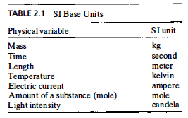
International conferences have established primary standards defining the units for seven physical variables. These units are known as the International System (SI) base units (Table 2.1).

Slide 23
All the primary standards except mass can, in theory, be reproduced in any laboratory having the proper equipment. They are called reproducible standards. Mass, the only standard that has an exact physical location, is called a fixed standard.
Although all primary standards except mass can be reproduced in any laboratory, this is not practical.
It is normal to create secondary standards. These standards must be traceable to the primary standards-that is, at some point, the secondary standard was compared either to a primary standard or to another secondary standard that is traceable to a primary standard.

Slide 24
Static Calibration Process In the calibration of a measuring system, the system is used to make measurements of known values of the measurand. Various values of the measurand must be used to cover the intended range of use of the measurement system.

Slide 25
The first step in the calibration process is to take a set of data consisting of measurement system output as a function of the measurand. A graphical presentation of these data is known as the calibration curve. Although this curve can be used directly to interpret the instrument output, in most cases the data are correlated using a mathematical function (the process of curve fitting).

Slide 26
when the measurand is changing in time and the measuring system does not show instantaneous response, the measurement process is said to be dynamic.

Slide 27
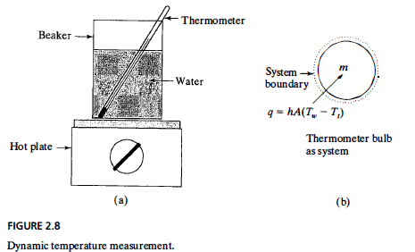
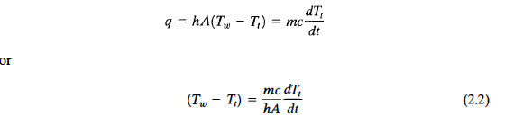
A bulb surface area
T_{w} water temperature
T_{t} thermometer temperature
h heat transfer coefficient
m bulb mass
c bulb specific heat
dT_{t}/dt time rate of change of the water temperature

Slide 28
There would be no error in the measurement if T_{w} = T_{t} However, if the water is being heated, dT_{t}/dt is nonzero, so T_{w} - T_{t} is nonzero and there exists an inherent dynamic measurement error.
The term mc/hA, called the time constant of the system, has dimensions of time and is usually given the symbol τ.
To minimize the dynamic error for this situation, τ should be made as small as is practical.

Slide 29
Ideal zero-order systems respond instantly to measurands, although no instrument is truly zero order. However, the dynamic response of many instruments approximate zero-order behavior when measuring slowly changing measurands.
First-order measurement systems show capacitance-type energy storage effects. Mechanical analogs to capacitance are springs and devices that store thermal energy. The common thermometer discussed above is an example of a first-order system.
Second-order systems have inertial effects of inductance or accelerated mass as well as capacitance energy storage. Common spring-mass systems are second order - the mechanical bathroom scale is an example.

Slide 30
Second-order systems include a characteristic called damping, which dissipates energy.
Second-order systems with low damping are called underdamped and can show oscillatory response.
Highly damped second-order systems are called overdamped and will not show oscillatory behavior.
The level of damping that divides these two modes of response is called critical damping.

Slide 31
There are specifications for the dynamic response of an instrument that can be used to select an appropriate device.
The two most common specifications characterize the response of the measurement system to a step change in input (called transient response) and the response to a range of sinusoidal inputs (called frequency response).

Slide 32
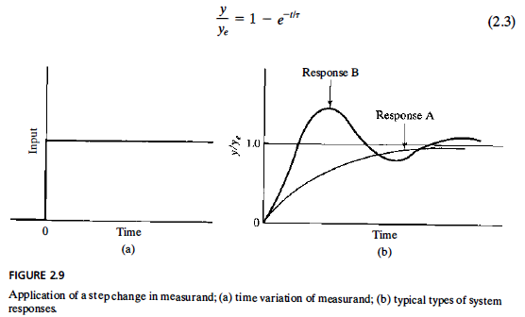

Slide 33
response time is a more general term used to specify transient response and can be used for first and second-order systems. For example, a 95% response time is the time at which y/y_{e} has a value of 0.95.
Another measure of transient response is the rise time. This is usually the time that it takes y/y_{e} to increase from 0.1 to 0.9.
For oscillatory responses [response B in Figure 2.9(b)], another term, called settling time, is more useful. This is the time until the amplitude of the oscillations are less than some fraction (e.g., 10% ) of the equilibrium response.

Slide 34
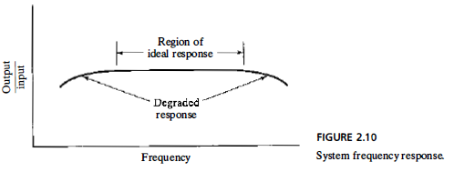
As shown in Figure 2.10, there is the range of sinusoidal input frequencies over which the measuring system gives a constant ratio of output amplitude to input amplitude.
This range of frequencies is called the bandwidth of the device

Slide 35
In some cases, the frequency response of a second-order system is specified with a single number called the natural frequency. In the spring scale example, if a weight is simply dropped on the platform, the device will oscillate for a period of time at the natural frequency.

